Slide 1
Text Mining
L04. Text categorization

Slide 2
Today’s lecture
Quiz about week 3
Text categorization introduction
The text categorization process
Task definition
( Example data )
Pre-processing
Feature extraction
Classifier learning
Evaluation

Slide 3
Quiz about week 3
How is a topic defined in LDA?
As a cluster of words from the collection
As a cluster of documents from the collection
As a probability distribution over the collection's vocabulary
As a probability distribution over the collection's documents

Slide 4
Quiz about week 3
What is the role of the dirichlet prior in LDA?
To initialize a random uniform distribution
To initialize a random sparse distribution
To optimize the number of topics in the collection
To optimize the number of terms per topic

Slide 5
Quiz about week 3
What is the role of the distributional hypothesis in training word embeddings?
Words that occur in similar contexts get similar representations
The embeddings get updated while the collection is processed
Randomly sampled non-context words are used as counter-examples
The distributional hypothesis makes word2vec a highly effective model

Slide 6
Quiz about week 3
Did you work on the exercise of week 3 (embeddings tutorial)
Yes, I completed it
Yes, I completed at least half of it
Yes, I started it
No

Slide 7
Exercise week 3 – word embeddings
https://www.guru99.com/word-embedding-word2vec.html
Please contact the TAs if you encountered any difficulties

Slide 8
About text categorization
(or text classification)

Slide 9
Binary classification
Multi-class / one-of classification
Multi-label classification
Notes:
In the book no distinction between multi-class and multi-label

Slide 10
Example applications
Is this task binary, multi-class or multi-label?

Slide 11
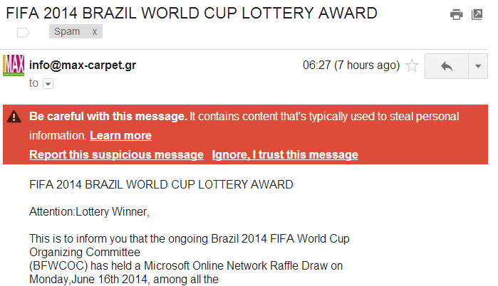
Spam classification

Slide 12
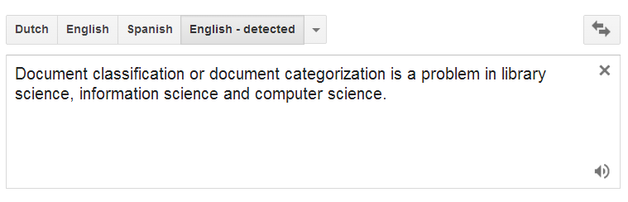
Language identification

Slide 13
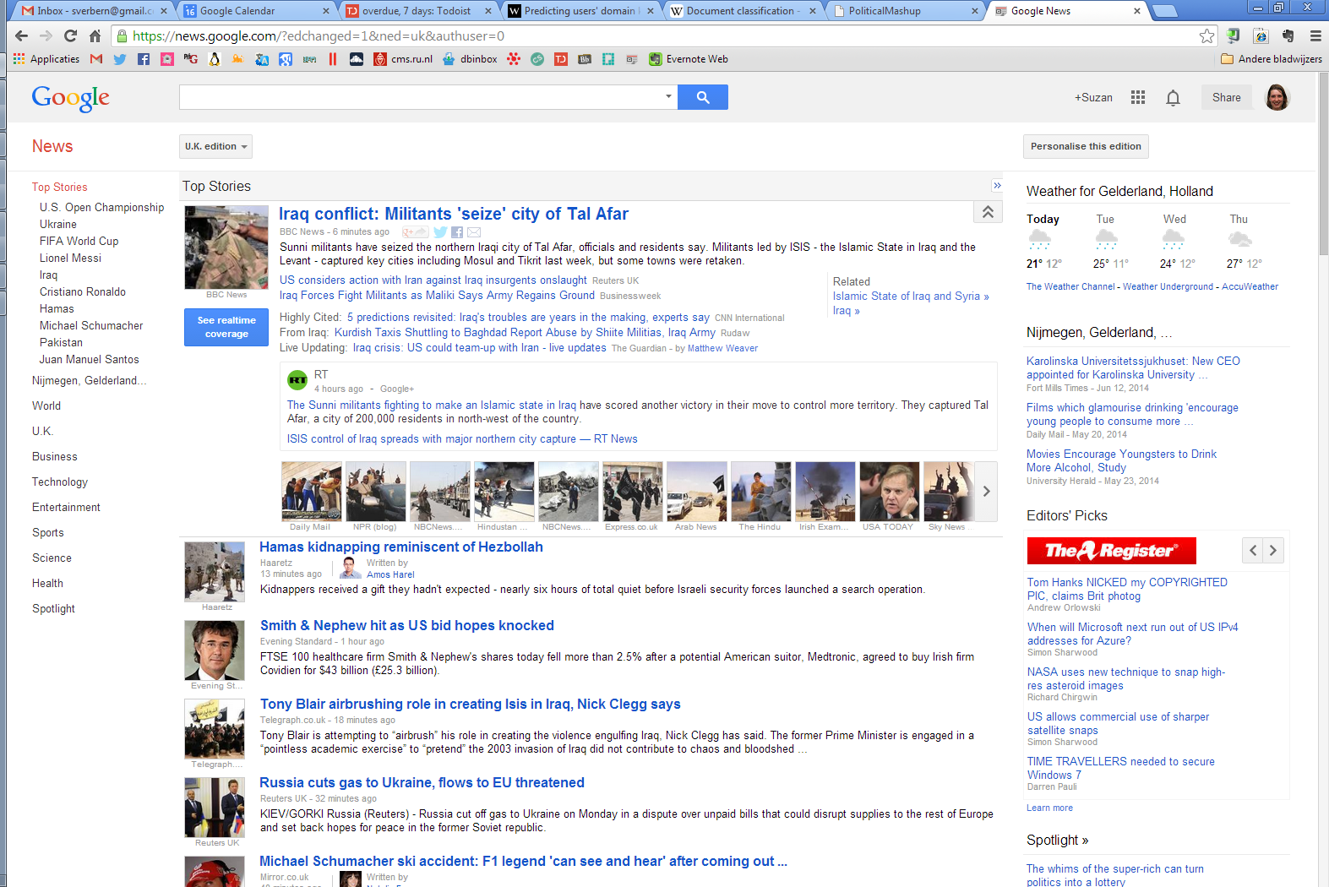
News sectioning

Slide 14
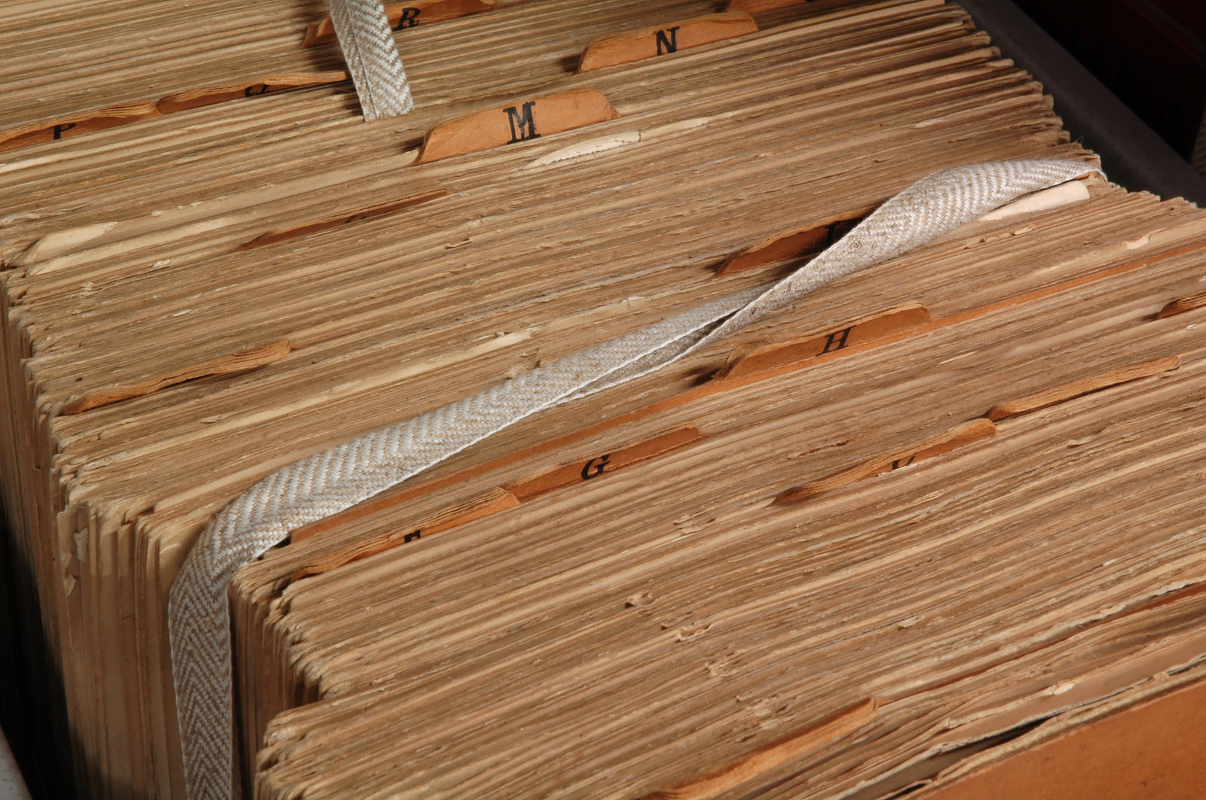
Adding keywords to archived documents

Slide 15
The text categorization process

Slide 16
What is needed for text classification
A definition of the task
Example data
Pre-processing
Feature extraction
Classifier learning
Evaluation

Slide 17
What is needed for text classification
A definition of the task
Example data
Pre-processing
Feature extraction
Classifier learning
Evaluation

Slide 18
Task definition
What is the text unit (a.k.a. ‘document’)?
Complete documents (emails, scientific articles)
Sections (minutes, speeches)
Sentences? (language identification, sentiment classification)

Slide 19
Task definition
What are the categories?
Spam/no spam
Language
Positive/negative/neutral
Topic
News section
…

Slide 20
What is needed for text classification
A definition of the task
Example data
Pre-processing
Feature extraction
Classifier learning
Evaluation

Slide 21
Pre-processing and feature extraction

Slide 22
Words as features
Doc id | Content | Class
1 | request urgent interest urgent | Spam
2 | assistance low interest deposit | Spam
3 | symposium defense june | No spam
4 | notas symposium deadline june | No spam
5 | registration assistance symposium deadline | ?

Slide 23
Words as features
Doc id | Content | Class
1 | request urgent interest urgent | Spam
2 | assistance low interest deposit | Spam
3 | symposium defense june | No spam
4 | notas symposium deadline june | No spam
5 | registration assistance symposium deadline | ?
Each item in the vocabulary becomes a feature/dimension in the vector space
Each document x_{i} is represented as a vector in this space
Each document has a label y_{i}
What is the vocabulary size of this training set?

Slide 24
Pre-processing
We need at least tokenization to get the words
Or we create even lower-level features: character k-grams
E.g. 4-grams:
“you will. To” → you_ ou_w u_wi _wil will ill. ll._ l._T ._To
For most applications, we apply lowercasing and removal of punctuation

Slide 25
Pre-processing
Additional pre-processing steps might include:
Remove stopwords
Lemmatization or stemming
Add phrases as features (e.g. “PhD defense”, “not good”)
Phrases: statistical (bigrams, trigrams) or linguistic (noun phrases)
Only in few domains the addition of phrases has proven to give better results

Slide 26
Pre-processing
Decide on vocabulary size (number of dimensions / number of distinct terms)
Feature selection

Slide 27
Feature selection
Goals:
Dimensionality reduction
Reduce overfitting
Global term selection: overall term frequency (e.g. 3) is used as cut-off (remove rare terms, the long tail)
Local term selection: Each term is scored by a scoring function that captures its degree of correlation with each class it occurs in (for example using the χ² test)
Only the top-n terms are used for classifier training

Slide 28
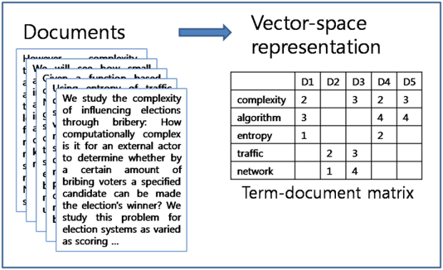
Term-document matrix
Once we have defined the terms in our vocabulary (the features), we assign them weights (feature values)

Slide 29
Term Weighting

Slide 30
Term weighting
Compute term weights
Binary: occurrence of term
Integer: term count
Real-valued: more advanced term weighting
Most used weighting scheme: TF-IDF (see also J&M Section 6.5)

Slide 31
Term weighting
Term frequency
The term count tc_{t,d} of term t in document d is defined as the number of times that t occurs in d.
Raw term count is not what we want because:
A document with tc = 10 is more relevant than a document with tc = 1
But not 10 times more relevant
Relevance does not increase proportionally with term frequency.
→ log frequency is more useful:

Slide 32
Term weighting
Term frequency
The term count tc_{t,d} of term t in document d is defined as the number of times that t occurs in d.
Raw term count is not what we want because:
A document with tc = 10 is more relevant than a document with tc = 1
But not 10 times more relevant
Relevance does not increase proportionally with term frequency.
→ log frequency is more useful:

Slide 33
Term weighting
Inverse document frequency:
Intuition: the most frequent terms are not very informative
df_{t} is the document frequency, the number of documents that t occurs in
df_{t} is an inverse measure of the informativeness of term t
We define the idf weight of term t as follows:

Slide 34
Term weighting
Inverse document frequency:
Intuition: the most frequent terms are not very informatve
df_{t} is the document frequency, the number of documents that t occurs in
df_{t} is an inverse measure of the informativeness of term t
We define the idf weight of term t as follows:
(N is the number of documents in the collection)
Tf-idf = tf * idf

Slide 35
exercise
We have a collection of 1 Million documents. The term ‘computer’ occurs in 100 documents. What is the inverse document frequency for ‘computer’?
We have a document with 10 times the word ‘computer’ What is the tf-idf weight for the term ‘computer’ in this document?

Slide 36
exercise
We have a collection of 1 Million documents. The term ‘computer’ occurs in 100 documents. What is the inverse document frequency for ‘computer’?
idf = log (N/100) = log (1000000/100) = log (10000) = 4
We have a document with 10 times the word ‘computer’ What is the tf-idf weight for the term ‘computer’ in this document?
tf = 1 + log(10) = 1+1 = 2
tf-idf = 2*4 = 8

Slide 37
What is needed for text classification
A definition of the task
Example data
Pre-processing
Feature extraction
Classifier learning
Evaluation

Slide 38
Classification methods (Section 15.5)
Estimators that are well-suited for text data (high-dimensional, sparse):
Naïve Bayes (MultinomialNB in sklearn)
Support Vector Machines (LinearSVC in sklearn)
When text is represented as dense embeddings vectors, we can use neural network architectures to train classifiers

Slide 39
Naive Bayes
J&M chapter 4

Slide 40
Naive Bayes Classification
Learning and classification method based on probability theory
Uses prior probability of each category given no information about an item
Classification produces a posterior probability distribution over the possible categories given a description of an item

Slide 41
Naive Bayes Classification
Naive Bayes classification method
Based on Bayes’ theorem:
Prior
Evidence

Slide 42
Naive Bayes Classification
Task: classify a new document d based on its feature representation
Maximum A Posteriori

Slide 43
Naive Bayes Classification
Learning the model: use the frequencies in the training data
Prior
the number of documents for class c
the total number of documents

Slide 44
Example
Doc id | Content | Class
1 | request urgent interest urgent | Spam
2 | assistance low interest deposit | Spam
3 | symposium defence june | No spam
4 | siks symposium deadline june | No spam
5 | registration assistance symposium deadline | ?
P(spam) = ?
P(no spam) = ?

Slide 45
Example
Doc id | Content | Class
1 | request urgent interest urgent | Spam
2 | assistance low interest deposit | Spam
3 | symposium defence june | No spam
4 | siks symposium deadline june | No spam
5 | registration assistance symposium deadline | ?
P(spam) = 2/4
P(no spam) = 2/4

Slide 46
Naive Bayes Classification
Learning the model: Use the frequencies in the data
the number of occurrences of t in training documents from class c
total number of term occurrences in training documents from class c

Slide 47
Example
Doc id | Content | Class
1 | request urgent interest urgent | Spam
2 | assistance low interest deposit | Spam
3 | symposium defence june | No spam
4 | siks symposium deadline june | No spam
5 | registration assistance symposium deadline | ?
P(spam) = 2/4
P(registration|spam) = ?
P(assistance|spam) = ?
P(symposium|spam) = ?
P(deadline|spam) =?
P(no spam) = 2/4
P(registration|no spam) = ?
P(assistance|no spam) = ?
P(symposium|no spam) = ?
P(deadline|no spam) = ?

Slide 48
Example
Doc id | Content | Class
1 | request urgent interest urgent | Spam
2 | assistance low interest deposit | Spam
3 | symposium defence june | No spam
4 | siks symposium deadline june | No spam
5 | registration assistance symposium deadline | ?
P(spam) = 2/4
P(registration|spam) = 0/8
P(assistance|spam) = 1/8
P(symposium|spam) = 0/8
P(deadline|spam)=0/8
P(no spam) = 2/4
P(registration|no spam) = ?
P(assistance|no spam) = ?
P(symposium|no spam) = ?
P(deadline|no spam) = ?

Slide 49
Example
Doc id | Content | Class
1 | request urgent interest urgent | Spam
2 | assistance low interest deposit | Spam
3 | symposium defence june | No spam
4 | siks symposium deadline june | No spam
5 | registration assistance symposium deadline | ?
P(spam) = 2/4
P(registration|spam) = 0/8
P(assistance|spam) = 1/8
P(symposium|spam) = 0/8
P(deadline|spam)=0/8
P(no spam) = 2/4
P(registration|no spam) = 0/7
P(assistance|no spam) = 0/7
P(symposium|no spam) = 2/7
P(deadline|no spam)=1/7

Slide 50
Naive Bayes Classification

Slide 51
Example
Doc id | Content | Class
1 | request urgent interest urgent | Spam
2 | assistance low interest deposit | Spam
3 | symposium defence june | No spam
4 | siks symposium deadline june | No spam
5 | registration assistance symposium deadline | ?
P(spam) = 2/4
P(registration|spam) = 0/8
P(assistance|spam) = 1/8
P(symposium|spam) = 0/8
P(deadline|spam)=0/8
P(no spam) = 2/4
P(registration|no spam) = 0/7
P(assistance|no spam) = 0/7
P(symposium|no spam) = 2/7
P(deadline|no spam)=1/7

Slide 52
Naive Bayes Classification
P(spam|registration assistance symposium deadline) =
2/4 * 0/8 * 1/8 * 0/8 * 0/8 = 0
P(no spam|registration assistance symposium deadline) =
2/4 * 0/7 * 0/7 * 2/7 * 1/7 = 0

Slide 53
Naive Bayes Classification
Problem with Maximum Likelihood Estimate: outcome is zero for a term-class combination that did not occur in the training data
In those cases, multiplication of probabilities for all terms will give a posterior probability of zero

Slide 54
Naive Bayes Classification
Solution: add-one smoothing (Laplace smoothing) = a uniform prior: assumption that each term occurs one additional time for each class

Slide 55
Doc id | Content | Class
1 | request urgent interest urgent | Spam
2 | assistance low interest deposit | Spam
3 | symposium defence june | No spam
4 | siks symposium deadline june | No spam
5 | registration assistance symposium deadline | ?
P(spam) = 2/4
P(registration|spam) =
P(assistance|spam) =
P(symposium|spam) =
P(deadline|spam) =

Slide 56
Doc id | Content | Class
1 | request urgent interest urgent | Spam
2 | assistance low interest deposit | Spam
3 | symposium defence june | No spam
4 | siks symposium deadline june | No spam
5 | registration assistance symposium deadline | ?
P(spam) = 2/4
P(registration|spam) = (0+1)/(8+11)
P(assistance|spam) = (1+1)/(8+11)
P(symposium|spam) = (0+1)/(8+11)
P(deadline|spam) = (0+1)/(8+11)

Slide 57
Doc id | Content | Class
1 | request urgent interest urgent | Spam
2 | assistance low interest deposit | Spam
3 | symposium defence june | No spam
4 | siks symposium deadline june | No spam
5 | registration assistance symposium deadline | ?
P(spam) = 2/4
P(registration|spam) = (0+1)/(8+11)
P(assistance|spam) = (1+1)/(8+11)
P(symposium|spam) = (0+1)/(8+11)
P(deadline|spam) = (0+1)/(8+11)
P(spam|registration assistance symposium deadline) =
2/4 * 1/19 * 2/19 * 1/19 * 1/19 = 7.67 * 10⁻⁶

Slide 58
Doc id | Content | Class
1 | request urgent interest urgent | Spam
2 | assistance low interest deposit | Spam
3 | symposium defence june | No spam
4 | siks symposium deadline june | No spam
5 | registration assistance symposium deadline | ?
P(no spam) = 2/4
P(registration|no spam) =
P(assistance|no spam) =
P(symposium|no spam) =
P(deadline|no spam) =
Exercise

Slide 59
Doc id | Content | Class
1 | request urgent interest urgent | Spam
2 | assistance low interest deposit | Spam
3 | symposium defence june | No spam
4 | siks symposium deadline june | No spam
5 | registration assistance symposium deadline | ?
P(no spam) = 2/4
P(registration|no spam) = (0+1)/(7+11)
P(assistance|no spam) = (0+1)/(7+11)
P(symposium|no spam) = (2+1)/(7+11)
P(deadline|no spam) =(1+1/7+11)
P(no spam|registration assistance symposium deadline) =
2/4 * 1/18 * 1/18 * 3/18 * 2/18 = 2.86 * 10⁻⁵

Slide 60
Example
P(spam|registration assistance symposium deadline) = 7.67 * 10⁻⁶
P(no spam|registration assistance symposium deadline) = 2.86 * 10⁻⁵

Slide 61
Example
P(spam|registration assistance symposium deadline) = 7.67 * 10⁻⁶
P(no spam|registration assistance symposium deadline) = 2.86 * 10⁻⁵
P(no spam|registration assistance symposium deadline) > P(spam|registration assistance symposium deadline)
→ This message is no spam

Slide 62
Naive Bayes Classification
Assumptions:
Conditional Independence Assumption: features are independent of each other given the class:
Positional Independence Assumption: the conditional probabilities of a term are the same, independent of the position in the document

Slide 63
Naive Bayes Classification
Classification results of Naive Bayes (the class with maximum posterior probability) are usually fairly accurate
However, due to the inadequacy of the conditional independence assumption, the actual posterior-probability numerical estimates are not
Output probabilities are generally very close to 0 or 1
Correct estimation ⇒ accurate prediction, but correct probability estimation is NOT necessary for accurate prediction (just need right ordering of probabilities)
A good baseline for text classification

Slide 64
What is needed for text classification
A definition of the task
Example data
Pre-processing
Feature extraction
Classifier learning
Evaluation

Slide 65
Classifier evaluation
J&M Section 4.7, 4.8

Slide 66
Test data
We use a held-out test set for evaluation.
Prevents overfitting on the training set
‘Fair’ evaluation

Slide 67
Test data
We use a held-out test set for evaluation.
Prevents overfitting on the training set
‘Fair’ evaluation
How?
Split the example data in a training set and a test set
E.g. 80% for training and 20% for testing
Or, in the case of small datasets, a rotating 20% (cross validation)
Define the features and train the classifier on the train set

Slide 68
Evaluation metrics
Why is accuracy often not suitable?
The 2 classes are often unbalanced. High accuracy in one class might mean low accuracy in the other class
Also, we might be more interested in correctness of the labels than in completeness of the labels, or vice versa
Alternative: use precision and recall

Slide 69
Precision and recall
Human classification = reference (true)
Automatic classification

Slide 70
Precision and recall
Human classification = reference (true)
Automatic classification
8 true categories
of which 5 assigned
Recall = 5/8
6 assigned categories
of which 5 correct
Precision = 5/6

Slide 71
Precision and recall
Human classification = reference (true)
Automatic classification
8 true categories
of which 5 assigned
Recall = 5/8
6 assigned categories
of which 5 correct
Precision = 5/6
We also report the mean, the F1:

Slide 72

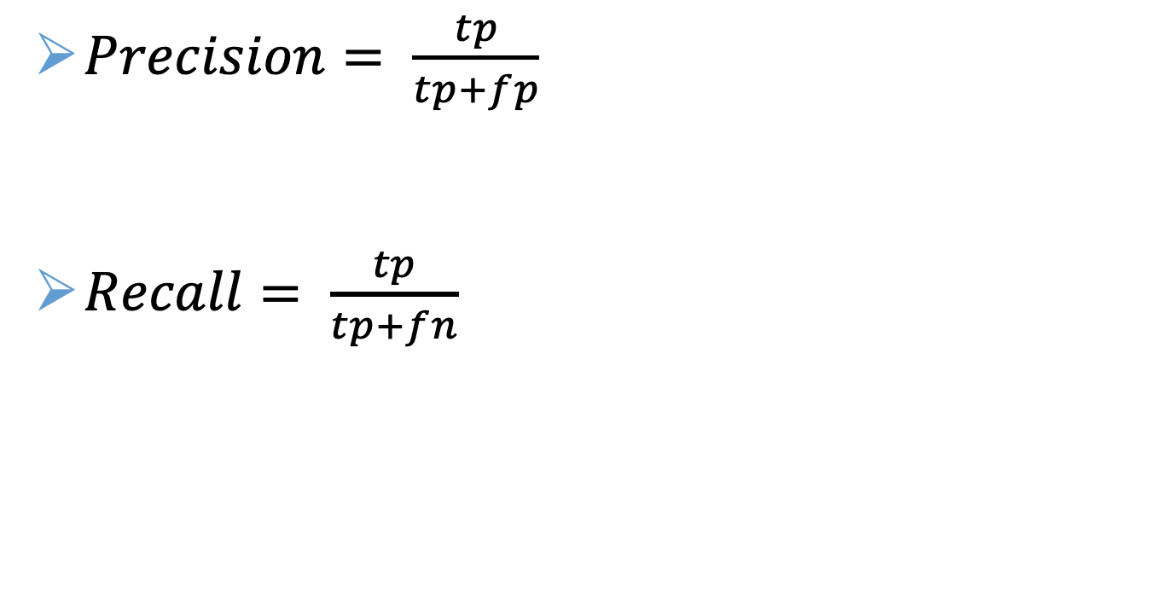
Precision and recall
$Precision= \frac{tp}{tp+fp}$
$Recall= \frac{tp}{tp+fn}$

Slide 73
Conclusions

Slide 74
Homework
Read:
Jurafsky & Martin chapter 4. Naive Bayes Classification
Exercise week 4: text categorization with sklearn
Follow the tutorial on:http://scikit-learn.org/stable/tutorial/text_analytics/working_with_text_data.html (the exercises are not required)
Make sure you understand what the steps mean
This is not a hand-in assignment. After next lecture, you will complete the 1st hand-in assignment on this topic

Slide 75
Homework
Form a group for the first assignment if you haven’t done that yet
Note that the assignment is only visible in Brightspace if you have enrolled in a group.

Slide 76
After this lecture…
you can give a few examples of text categorization applications
you can describe the pre-processing needed for text categorization
you can compute the tf-idf weight for a term given its term count, document count, and corpus size
you can compute a Naive Bayes classifier given a toy data set
you can evaluate classification results using precision and recall

